Slide 1
IDENTIFYING AND UNDERSTANDING HIGH-RISK ACCIDENT ZONES IN UNITED STATES: A DATA DRIVEN APPROACH
AKANKSHA PATIL (AVP5576) || GAURAVJIT SINGH GILL (GSG7817) || KOYEL DAS (KD3075) || SANYOGITA DESHMUKH (SSD9792) || SATYAJIT SRIRAM (SS17492)

Slide 2
ACCIDENTS IN USA
42K
Road accidents in the United States claimed over 42000 lives last year and several over 100 thousand people have been hospitalized due to the same reason
CA
FL
TX
SC
NY
NC
49
1.5M
40
Dataset contains 49 out of 50 US States
This dataset contains approximately 1.5 million accident records at the moment
This dataset contains over 40 columns describing the nature of the accident

Slide 3
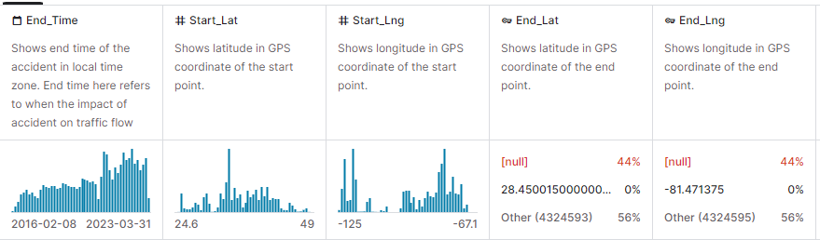
DATA CLEANING
REQUIRED COLUMNS:
TARGET VERIABLE: ‘Severity’
GENERAL FACTORS: 'Start_Time’, 'End_Time', 'Description', 'Street', 'City’, 'County', 'State', 'Zipcode’
WEATHER FACTORS: 'Temperature(F)', 'Humidity(%)''Visibility(mi)', 'Precipitation(in)’.
ROAD FACTORS: 'Amenity', 'Bump', 'Crossing’, Give_Way', 'Junction', 'No_Exit', 'Railway', 'Roundabout', 'Station’, 'Stop', 'Traffic_Calming', 'Traffic_Signal’, 'Turning_Loop',

Slide 4
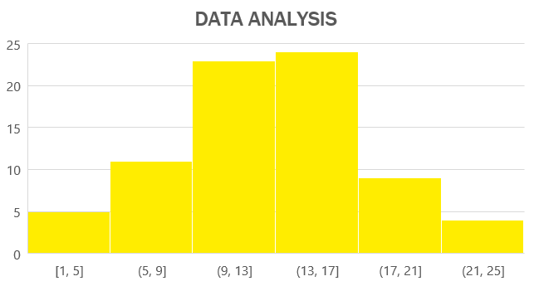
EXPLORATORY DATA ANALYSIS
City Analysis
State Analysis
Hour Analysis
Street Analysis
Severity Analysis
Weather Analysis
Temperature
Humidity
Visibility
Precipitation

Slide 5
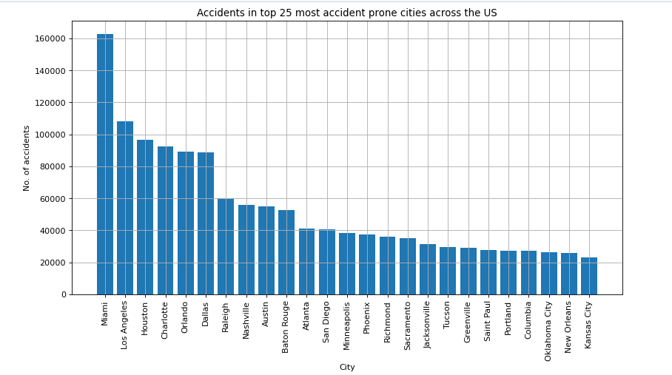
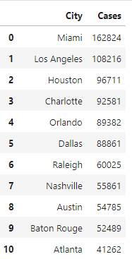
CITY ANALYSIS

Slide 6
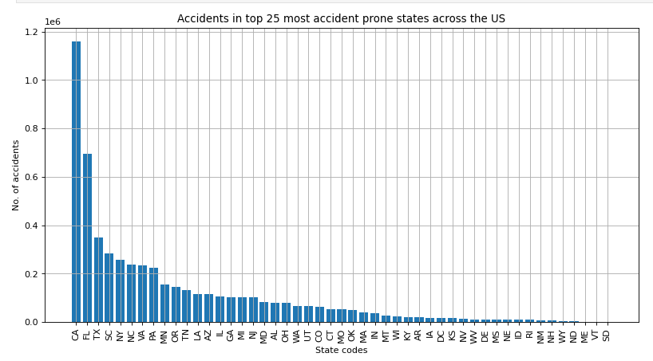
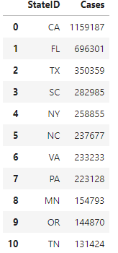
STATE ANALYSIS

Slide 7
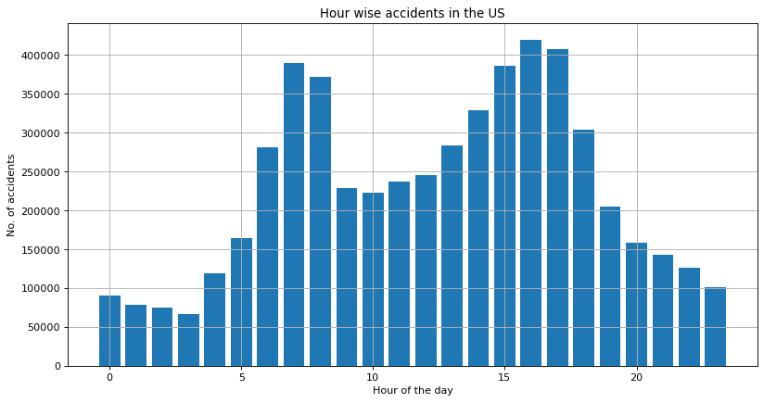
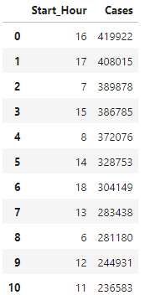
HOUR ANALYSIS

Slide 8
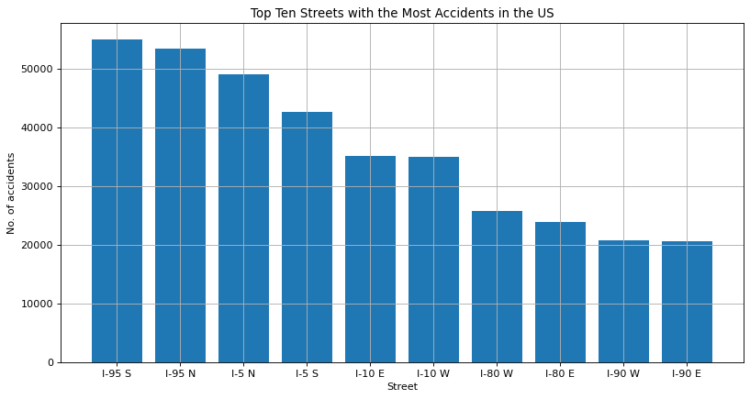
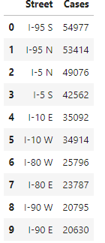
STREET ANALYSIS

Slide 9
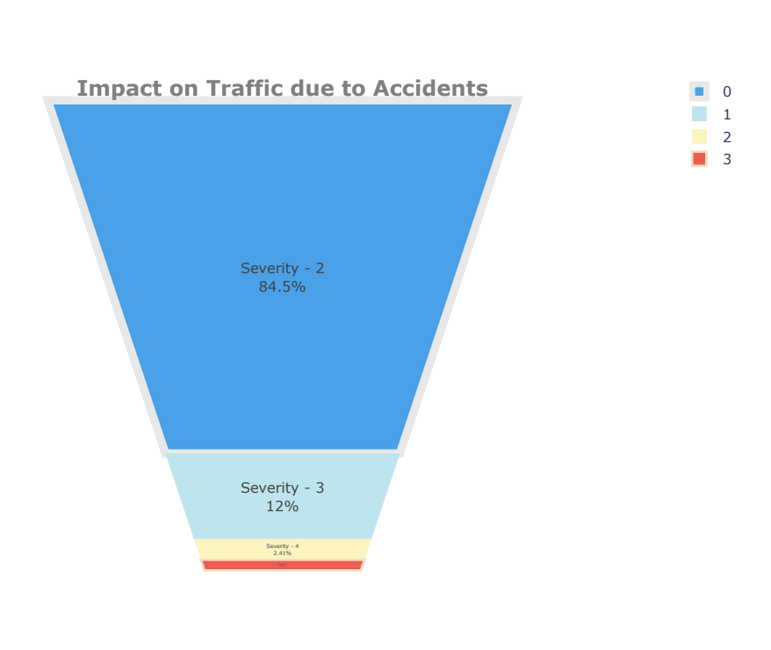
SEVERITY ANALYSIS
The severity rating ranges from 1 to 4, with 1 indicating minor impact (short delay) and 4 indicating major impact (long delay) on traffic.

Slide 10
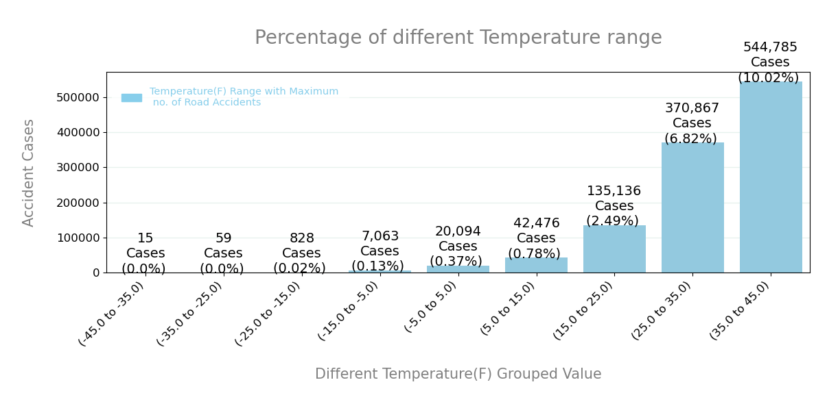
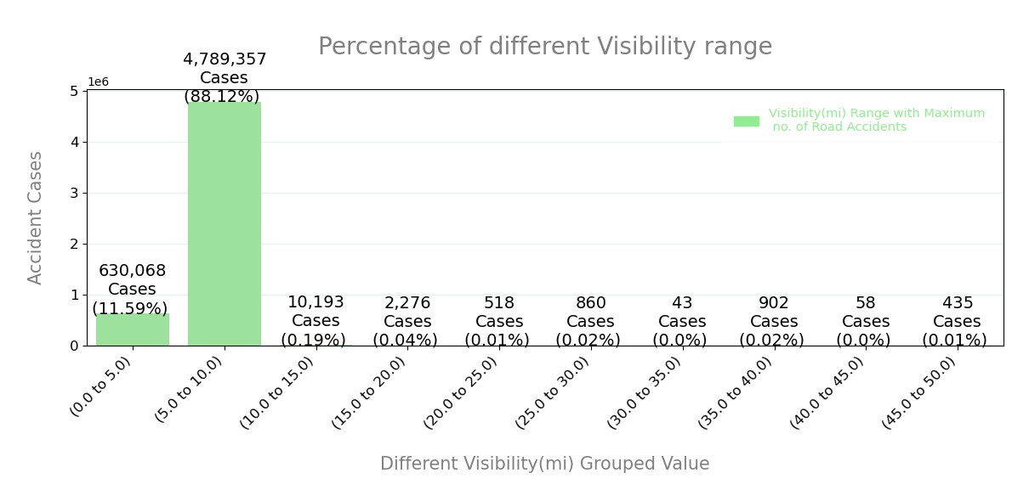
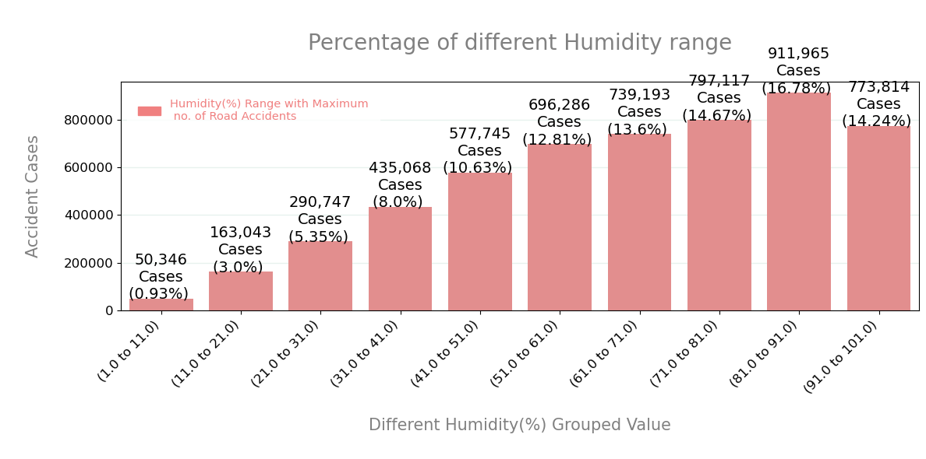
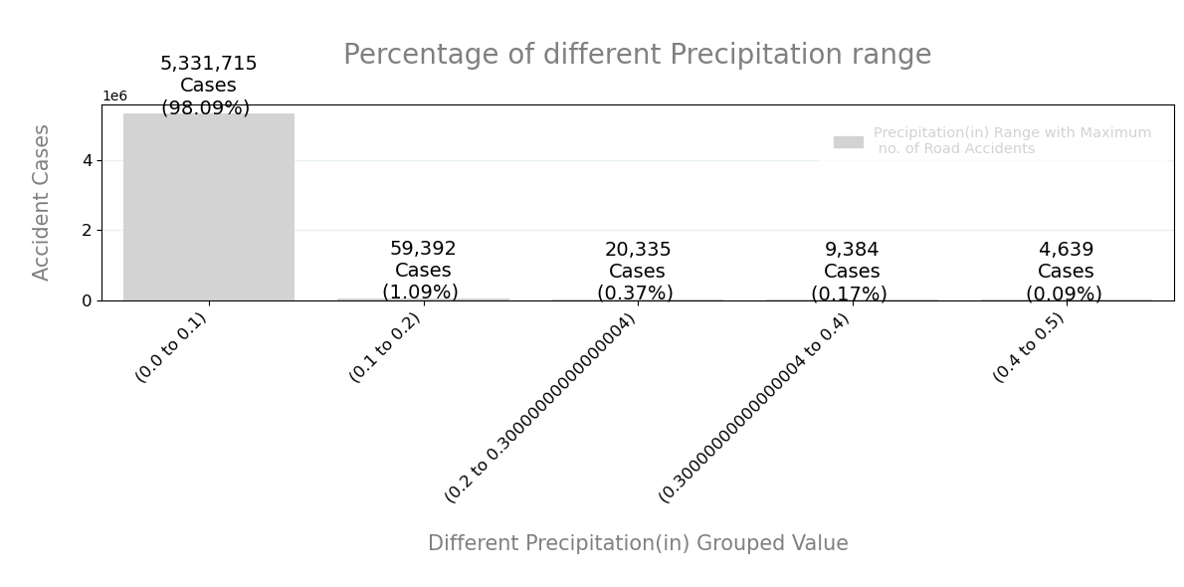
WEATHER ANALYSIS

Slide 11
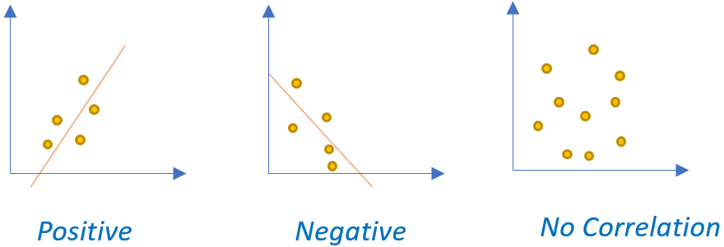
HYPOTHESIS TESTING
PEARSON CORRELATION
SPEARMAN CORRELATION
NORMAL CORRELATION

Slide 12
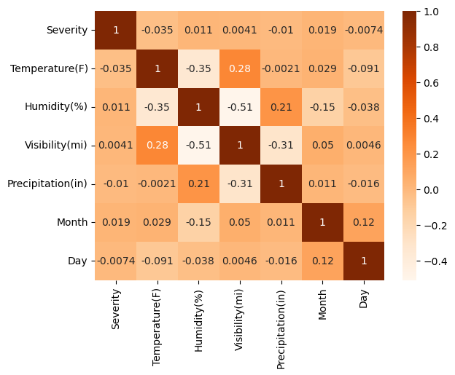
PEARSON CORRELATION
PEARSON CORRELATION:
Used for linear relationships under normal distribution, assessing how weather factors linearly related to severity.
Temperature and Humidity have a moderate negative correlation (-0.351).
High Humidity correlates with lower Visibility (-0.510).
Precipitation and Visibility show a moderate negative correlation (-0.308).
Notes:
Sanyogita (slide 11-15)

Slide 13
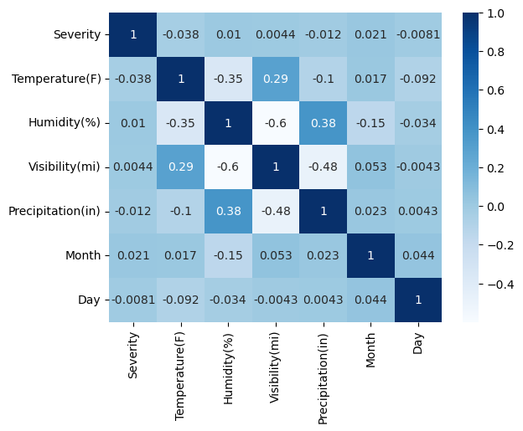
SPEARMAN CORRELATION
SPEARMAN CORRELATION:
Applied for non-normal data, capturing monotonic (increasing/decreasing) relationships between weather factors and severity.
Temperature and Humidity exhibit a moderate negative correlation (-0.351).
A strong negative correlation between Humidity and Visibility (-0.598).
Precipitation and Visibility show a notable negative correlation (-0.484).
Notes:
Sanyogita (slide 11-15)

Slide 14
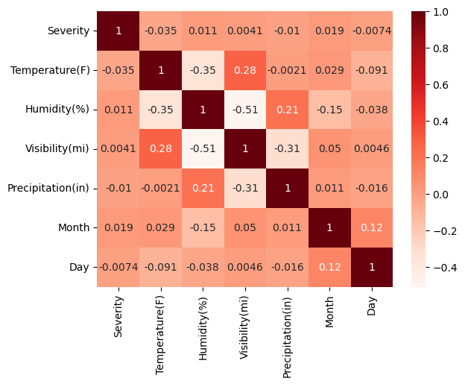
NORMAL CORRELATION
NORMAL CORRELATION
Provides insights into linear relationships, enhancing understanding when combined with Spearman analysis
Temperature and Humidity have a moderate negative correlation (-0.351).
Humidity is strongly negatively correlated with Visibility (-0.510).
Visibility and Precipitation show a moderate negative correlation (-0.308).
Notes:
Sanyogita (slide 11-15)

Slide 15
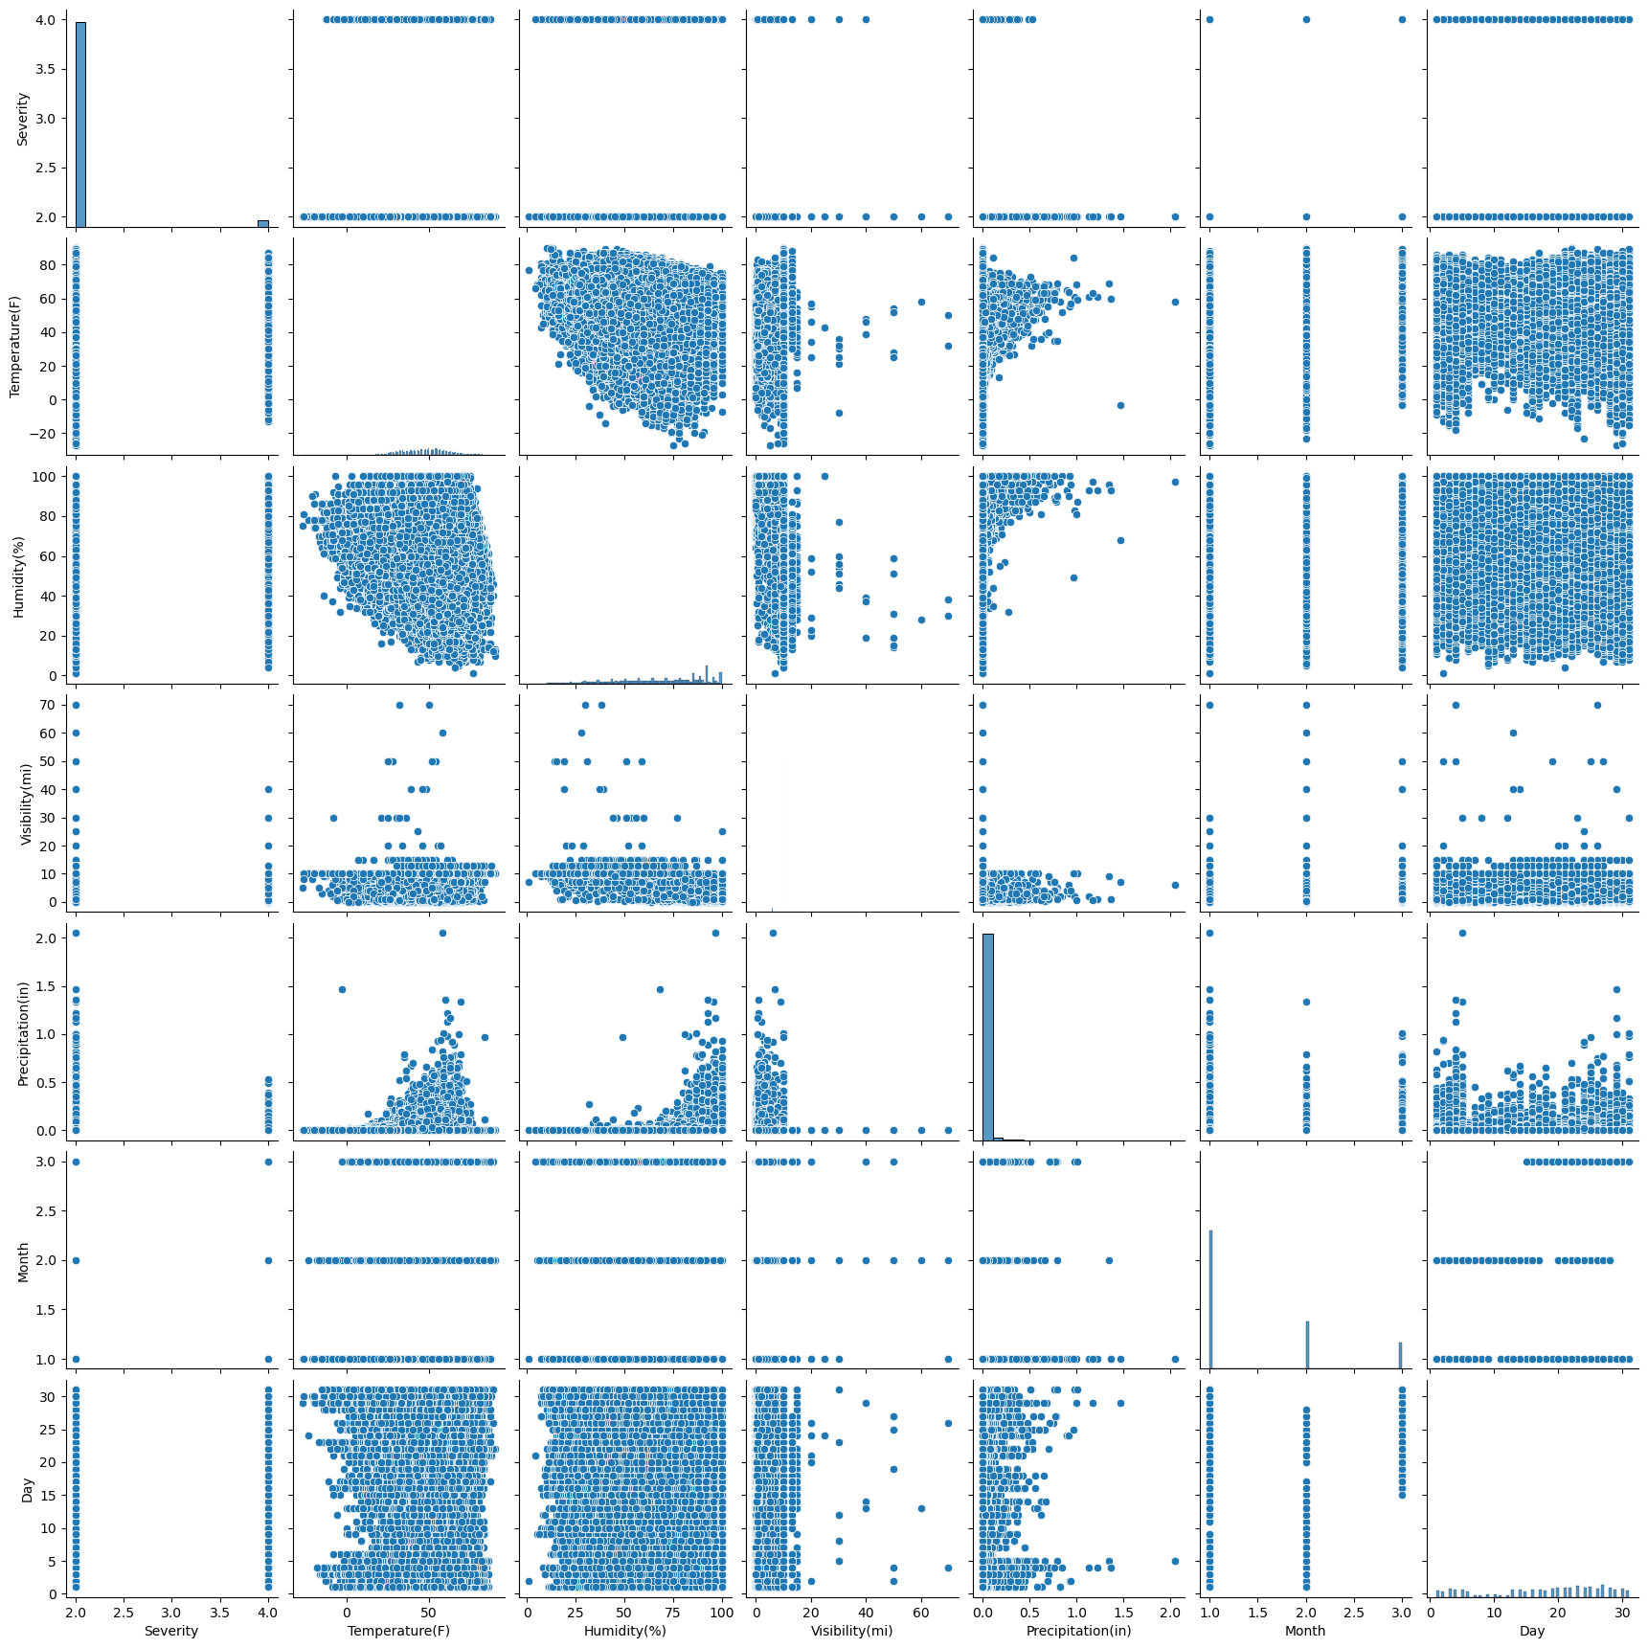
PAIRPLOT VISUALIZATION
PAIRPLOT VISUALIZATION
Severity Distribution: Histogram on the diagonal shows the frequency of different severity levels.
Temperature vs. Severity: Scatterplot indicates a very weak negative correlation, as evidenced by the slight dispersion trend.
Humidity vs. Visibility: Noticeable pattern suggesting a strong negative correlation; higher humidity is associated with lower visibility.
Notes:
Sanyogita (slide 11-15)

Slide 16
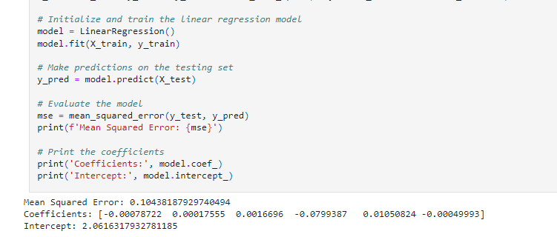
LINEAR REGRESSION MODEL

Slide 17
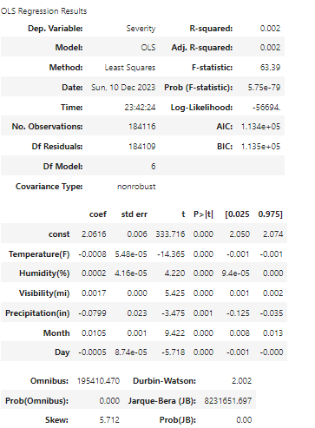
ORDINARY LEAST SQUARES REGRESSION MODEL

Slide 18
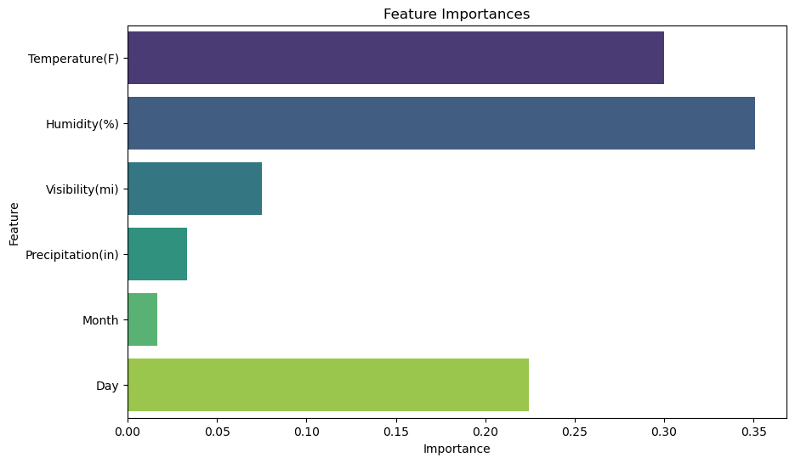
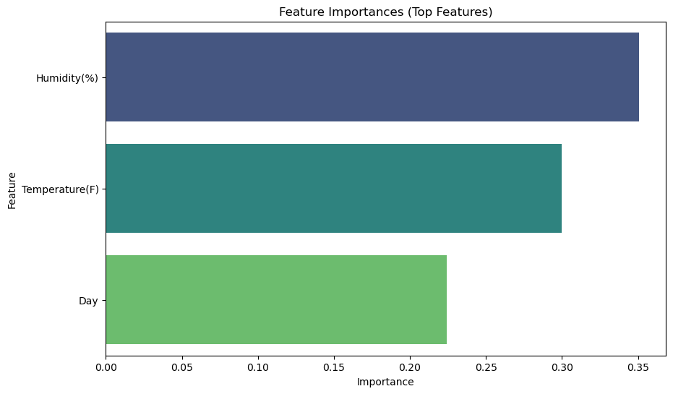
RANDOM FOREST CLASSIFIER

Slide 19
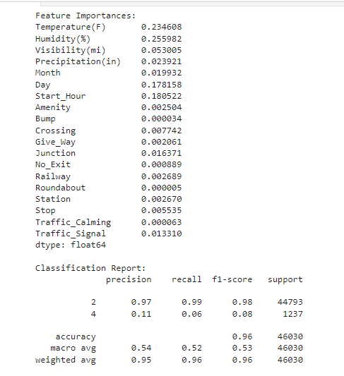
RANDOM FOREST CLASSIFIER

Slide 20
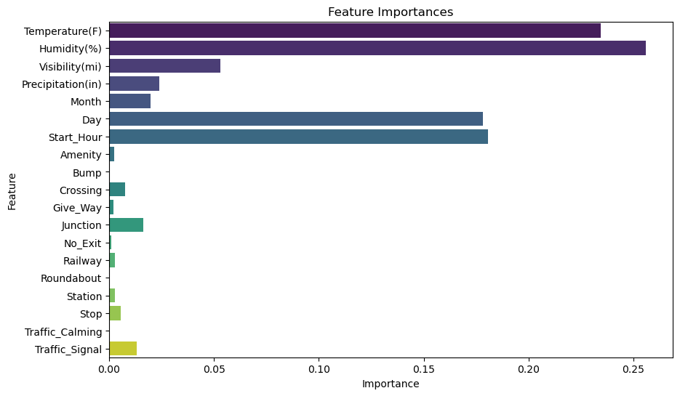
RANDOM FOREST CLASSIFIER

Slide 21
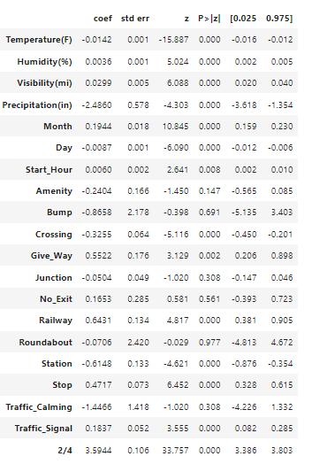
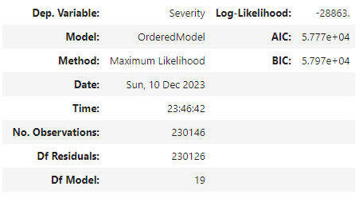

ORDINAL LOGISTIC REGRESSION

Slide 22
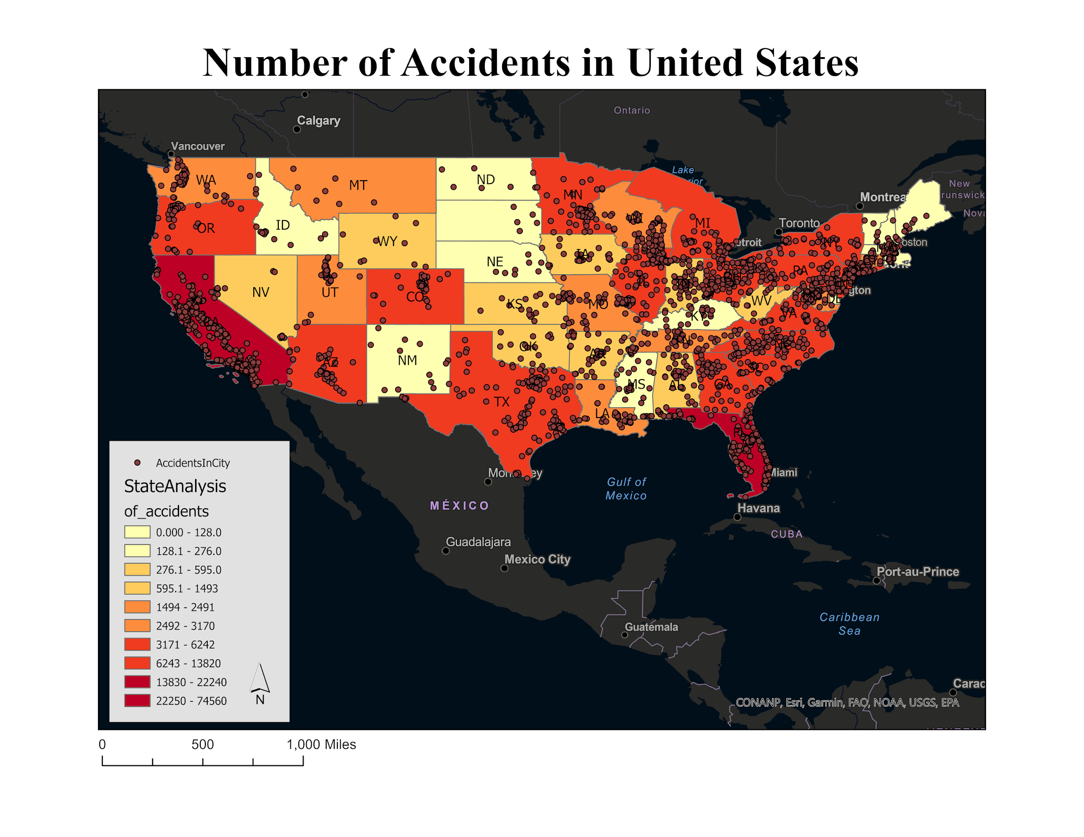
ORDINAL MODEL
CONCLUSION
Extensive study on traffic accidents identified key factors, including weather conditions, influencing severity. Rigorous data analysis, regression modeling, and Random Forest classification validated relationships. Feature importance analysis offered actionable insights for policymakers. This integrated statistical and machine learning approach provides valuable information to enhance road safety and optimize accident prevention resources, contributing significantly to public safety measures.

